Slide 1
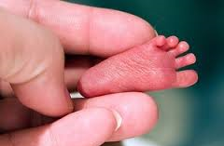
72 HRS
Start:___/___/___ at ___:___
Stop:___/___/___ at ___:___
Please handle me with care…

