Slide 1

COVIDIEN, COVIDIEN with logo, Covidien logo and positive results for life are U.S. and internationally registered trademarks of Covidien AG. Other brands are trademarks of a Covidien company. ©2010 Covidien. All rights reserved. 10-PM-7382
INVOS™ System
Cerebral/Somatic Oximetry in Pediatric Patients – Detecting Regional Ischemia
Notes:
1

Slide 2
INVOS™ System
Technology Overview
2 |
Covidien Respiratory and Monitoring Solutions | August 15, 2019 | Confidential
Notes:
2

Slide 3
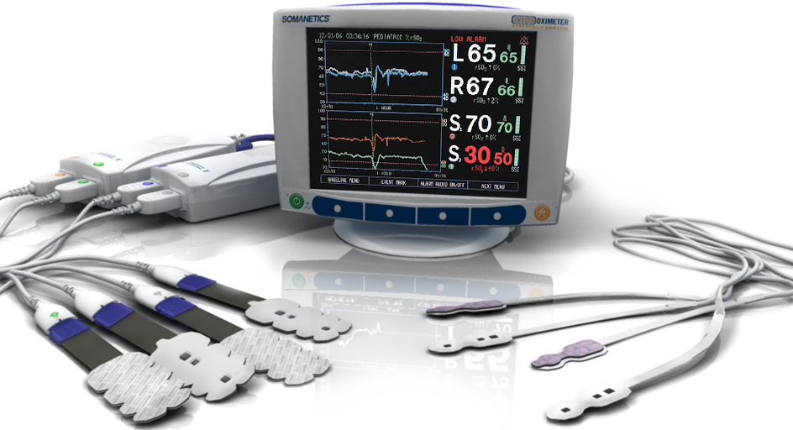
The INVOS™ System
OxyAlert™ NIRSensor for infants and neonates
Pediatric
SomaSensor™
Four Channel NIRS Monitoring
3 |
Covidien Respiratory and Monitoring Solutions | August 15, 2019 | Confidential
Notes:
Objective #2: INVOS™ System Introduction
Optical NIRS-based technology
Noninvasive measure of the adequacy of tissue perfusion
The most commonly monitored areas are the left and right hemispheres of the brain, the peri-renal area and the abdomen.
The system is indicated for use on patients of any age or size.
Our system provides real-time data accuracy in patients above 2.5 kg, and is intended for trend monitoring in patients less than 2.5 kg
3

Slide 4
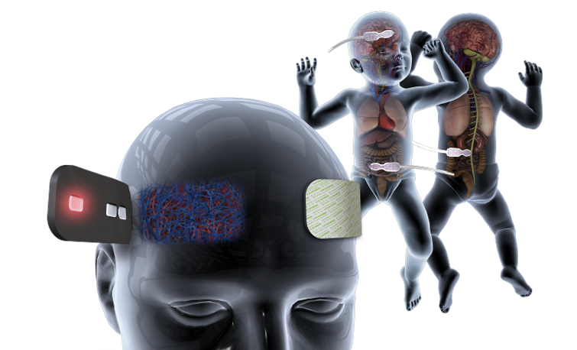
The INVOS™ System
Near infrared spectroscopy (NIRS)
Provides clinically unique data on the adequacy of perfusion in tissue beneath the sensor
Perfusion-related data from various tissue beds
4 |
Covidien Respiratory and Monitoring Solutions | August 15, 2019 | Confidential
Notes:
OBJECTIVE #2: INVOS™ System Introduction
Optical NIRS-based technology
Noninvasive measure of the adequacy of tissue perfusion
Tissue interrogation in adult, pediatric and neonatal patients
INVOS™ System technology offers you a “window” into the microvasculature – the site of gas exchange
It allows you to monitor both cerebral and somatic tissues to help with insight into the distribution of perfusion
Measurement of the cerebral, peri-renal and mesenteric tissue beds have been proven sensitive indicators of deteriorating patient condition
References for last bullet above: (just four, there are more if needed)
Casati A, et al. Anesth Analg. 2005;101(3):740-7.
Murkin JM, et al. Anesth Analg. 2007;104(1):51-8.
Tweddell JS, et al. Semin Thorac Cardiovasc Surg Pediatr Card Surg Ann. 2010;13:44-50
Kaufman J, et al. Pediatr Crit Care Med. 2008 Vol 9, No. 1
4

Slide 5
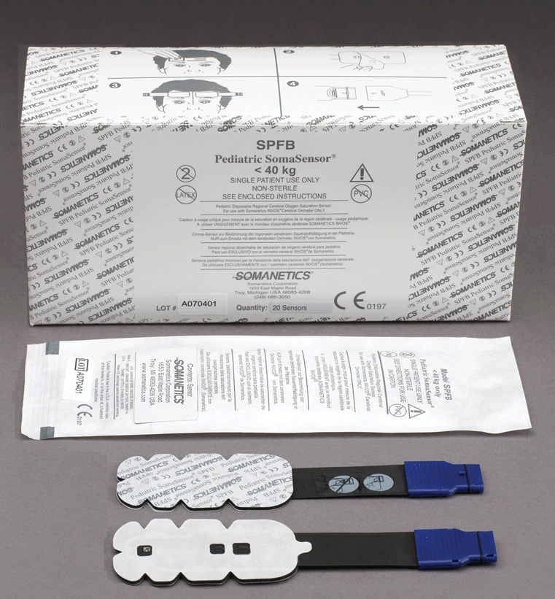
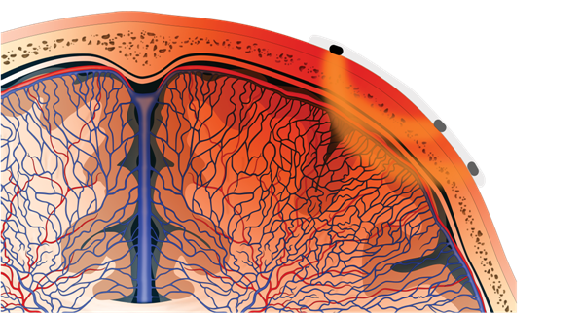
How the INVOS System Works
SomaSensor
Light
Emitting
Diode
Skin
Surface
Photodetector
Skull
Cerebral
Cortex
Deep
Photodetector

Slide 6
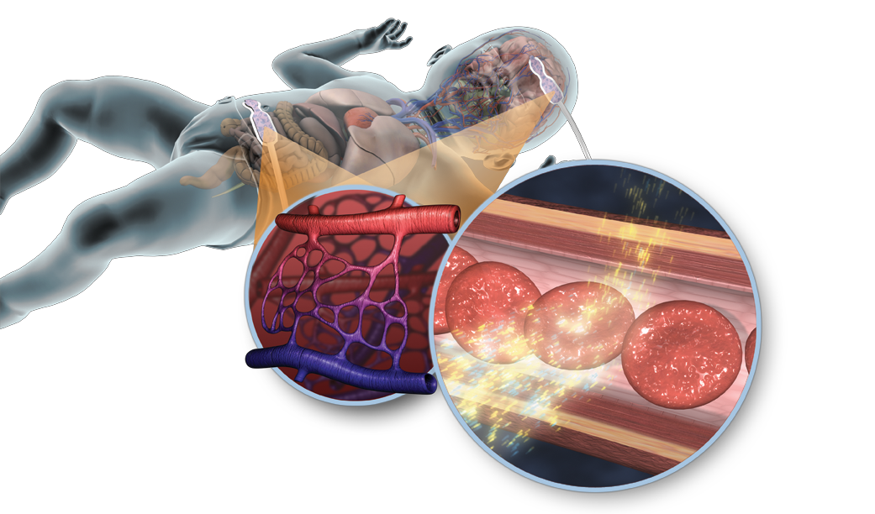
Dual Wavelength Design
Absorbance of near infra-red light waves
by oxy and de-oxy hemoglobin provides the basis for O₂ saturation calculation
Proven Oximetric Technology
Notes:
Objective #3: Mechanism of Action
Physics of device
Sensitivity of measurement
Biology of microvasculature
Value of measuring the venous oxygen reserve
Most biological tissues are transparent to infrared light (700-1000nm), with the exception of hemoglobin and cytochrome oxidase.
Capillary bed with light beam (illustrate 730nm/810nm)
Blood cell image reflecting the beam (oxy state)
Blood cell image reflecting slightly smaller width beam (de-oxy state)
Amount of absorbance by hemoglobin depends on oxygen status
6

Slide 7
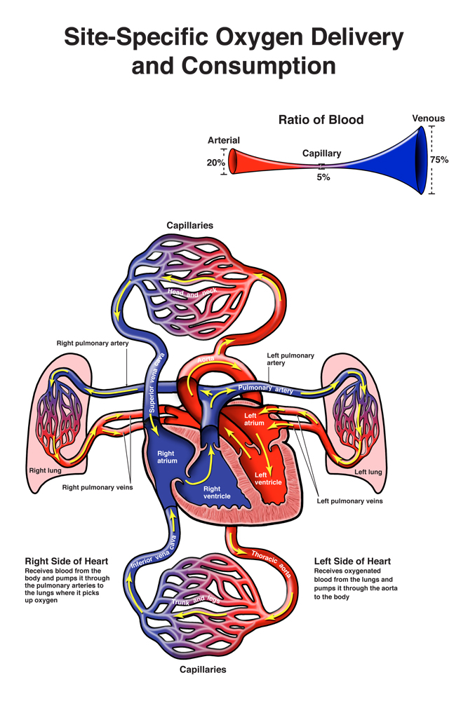
How the INVOS System Works
rSO₂ index represents the balance of site-specific O₂ delivery and consumption
It measures a mixture of venous (~75%) and arterial (~25%) blood
Indicates adequacy of site-specific tissue perfusion in real-time
Correlates positively with SvO₂, but is site-specific and noninvasive

Slide 8
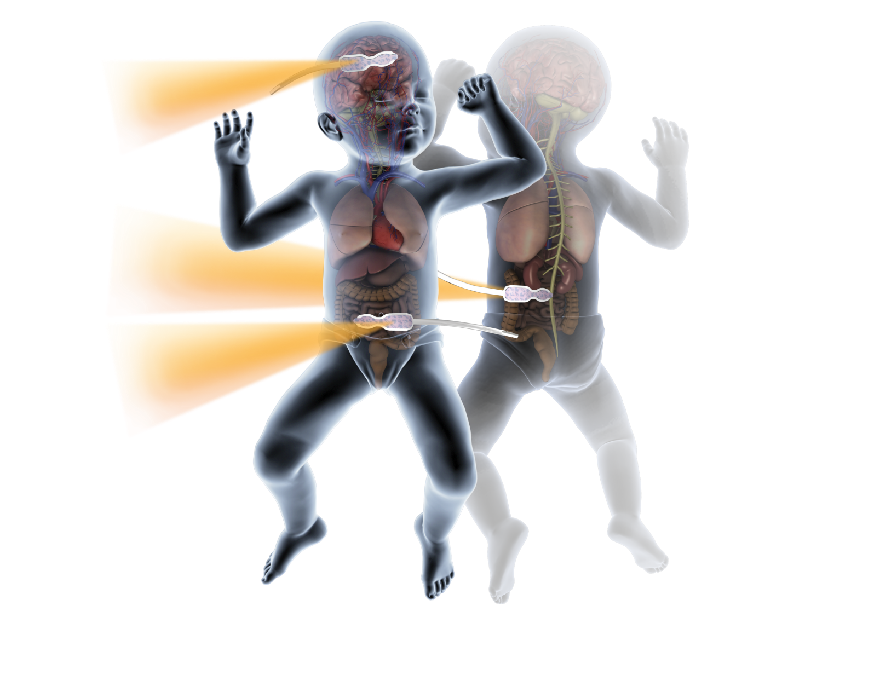
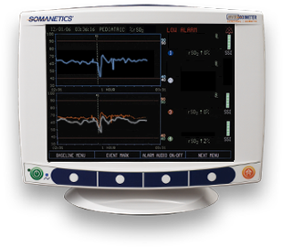
INVOS System – Clinical Application
Cerebral rSO₂:
High Flow/High O₂ extraction tissue
Typical range 60%-80%
Peri-Renal rSO₂:
Variable flow/lower extraction tissue
Typical range 5% - 20% > CrSO₂
Abdominal rSO₂:
Variable flow/lower extraction tissue
C70
66
A77
77
R79
87
Values based on published study data on congenital heart patients
Hoffman GM, et al. Semin Thorac Cardiovasc Surg Pediatr Card Surg Annu. 2005:12-21.
Hoffman GM, et al. Anesthesiology. 2005;103:A1327.
Petrova A et al. Pediatr Crit Care Med. 2006;7(5):449-454.
Dent CL, et al. J Thorac Cardiovasc Surg. 2005;130(6):1523-30.
8 |
Covidien Respiratory and Monitoring Solutions | August 15, 2019 | Confidential
Notes:
6. Differentiate INVOS™ System measurement from traditional systemic parameters
Target tissue measurement to assess balance of hemodynamics
High sensitivity, early warning measurement
Normal values for the rSO₂ measurement vary between specific tissue beds being monitored
This variability is reflective of the metabolic characteristics and perfusion status of the tissue.
The brain is high flow, high extraction organ with a normal range 60%-80%,
The kidney, high flow, low extraction organ with a normal range typically 5%-20% > CrSO₂
The gut exhibits more variable blood flow, with rSO₂ ranges varying with gestational age
These normal values are based on published study data on congenital heart patients
8

Slide 9
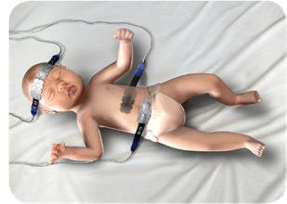
Monitor Set Up
Sensor Selection
Sensor Placement
9 |
Covidien Respiratory and Monitoring Solutions | August 15, 2019 | Confidential
Notes:
9

Slide 10

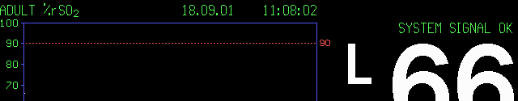

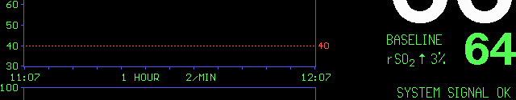




B
N
C
D
F
A. Adult/Pediatric
Indication
B Trend Data
C. Date and Time
D. Alarm Limits
E. Time Window
Scale;
F. Battery Powered
Status Message
G. Digital rSO2 (%)
reading, (updated
continuously while
monitoring)
H. Status Messages
I. Baseline Status
J. Power On/Off
K. Run/Pause
L. Menu Options
N. Trending Rate
Message Area
(
A
G
E
H
I
L
K
J

Slide 11
Targets & Thresholds
NICU/PICU Interventions
11 |
Covidien Respiratory and Monitoring Solutions | August 15, 2019 | Confidential
Notes:
11

Slide 12
rSO₂ Target & Thresholds
Targets and thresholds are expressed in rSO₂ real-time values and % changes from baseline. Both values have been proven clinically accurate.
Cerebral
  High flow, high extraction organ
  Typical range: 60-80
  < 50 rSO₂ or 20% Δ from rSO₂ baseline is common intervention trigger
  < 45 rSO₂ or 25% Δ from rSO₂ baseline is critical threshold
Somatic
  Variable flow, lower O₂ extraction
  5-20 points higher than cerebral rSO₂ ; changes in this cerebral - somatic variance may be indicative of pathology.
Hoffman GM, et al. Semin Thorac Cardiovasc Surg Pediatr Card Surg Annu. 2005:12-21.
Petrova A and Mehta R. Pediatr Crit Care Med 2006;7:449-454.
Dent CL, et al. J Thorac Cardiovasc Surg. 2006 Jan;131(1):190-7.
Data on file.

Slide 13
rSO₂ Reflects Oxygen Balance
rSO₂
Increases with rise in delivery or fall in demand
Decreases when delivery falls or if there is an uncompensated rise in demand
Oxygen Delivery/Supply
Influenced by:
Oxygen Content
  - Hemoglobin concentration
  - Hemoglobin saturation
Cardiac Output
  - Optimize heart rate
  - Idealize preload
  - Improve contractility
  - Manipulate afterload
Oxygen Demand/Consumption
Increased by:
Fever, shivering
Malignancy, severe infection
Cold stress (neonates)
Seizures, status epilepticus
Wounds and burns
Pain
Decreased by:
Hypothermia, without shivering
Sedation and paralysis
Shunting or decreased extraction

Slide 14

INVOS™ System Data and Standard Markers of Perfusion
rSO₂
Delayed CRT
Metabolic Acidosis
Diminished Pulses
BP
Oliguria
Color Δ
Lactate
Cold extremities
Creatinine
MARKERS OF PERFUSION
Immediate Minutes Hours
Hypotension/
Cardiac
Arrest
Color Δ
Cold Extremities
Lactate
BP
Oliguria
⬇ Pulses
Delayed CRT
Metabolic Acidosis
Creatinine
rSO₂
INCREASED RISK OF IRREVERSIBLE CELL/TISSUE DAMAGE
Courtesy of William I. Douglas, M.D.
14 |
Covidien Respiratory and Monitoring Solutions | August 15, 2019 | Confidential
Notes:
6. Differentiate INVOS™ System measurement from traditional systemic parameters
Target tissue measurement to assess balance of hemodynamics
High sensitivity, early warning measurement
Definitions
CRT = capillary refill time
Oliguria = reduced urine output
The site of measurement gives the INVOS™ System the ability to rapidly detect local changes in tissue perfusion.
The progression of cardiovascular collapse or shock can be demonstrated in changes in standard markers of perfusion.
The standard markers of perfusion are often subjective physical assessment and others are latent indicators of already altered physiology.
rSO₂ is highly sensitive to acute regional changes in perfusion adequacy and displays this information in real time.
This gives you the opportunity to intervene early – increasing the ability to reverse ischemia before permanent damage has already been done.
14

Slide 15
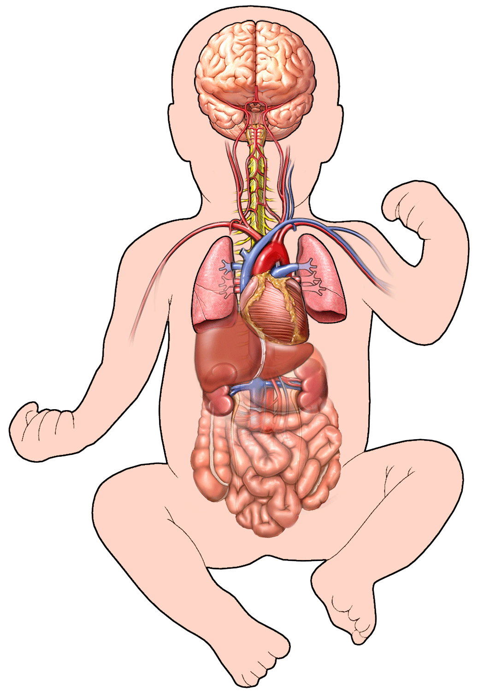
PICU Interventions to Improve rSO₂ - Cerebral
Cerebral
Increase cerebral perfusion pressure
  Increase blood pressure
  Increase systemic vascular resistance
  Increase cardiac output
  Reduce central venous pressure
Increase arterial oxygen content
  Transfuse red blood cells
  Raise arterial partial pressure of oxygen
Reduce cerebral metabolic rate
  Control hyperthermia
  Sedation
Reduce cerebral vascular resistance
  Raise arterial partial pressure of carbon dioxide
Hoffman GM, Cardiol Young 2005;15(Suppl. 1):149-153.
Mott AR, et al. Pediatr Crit Care Med 2006;7:346-350.
Copyright © 2006 Nucleus Medical Art, Inc.
All rights reserved. www.nucleusinc.com

Slide 16
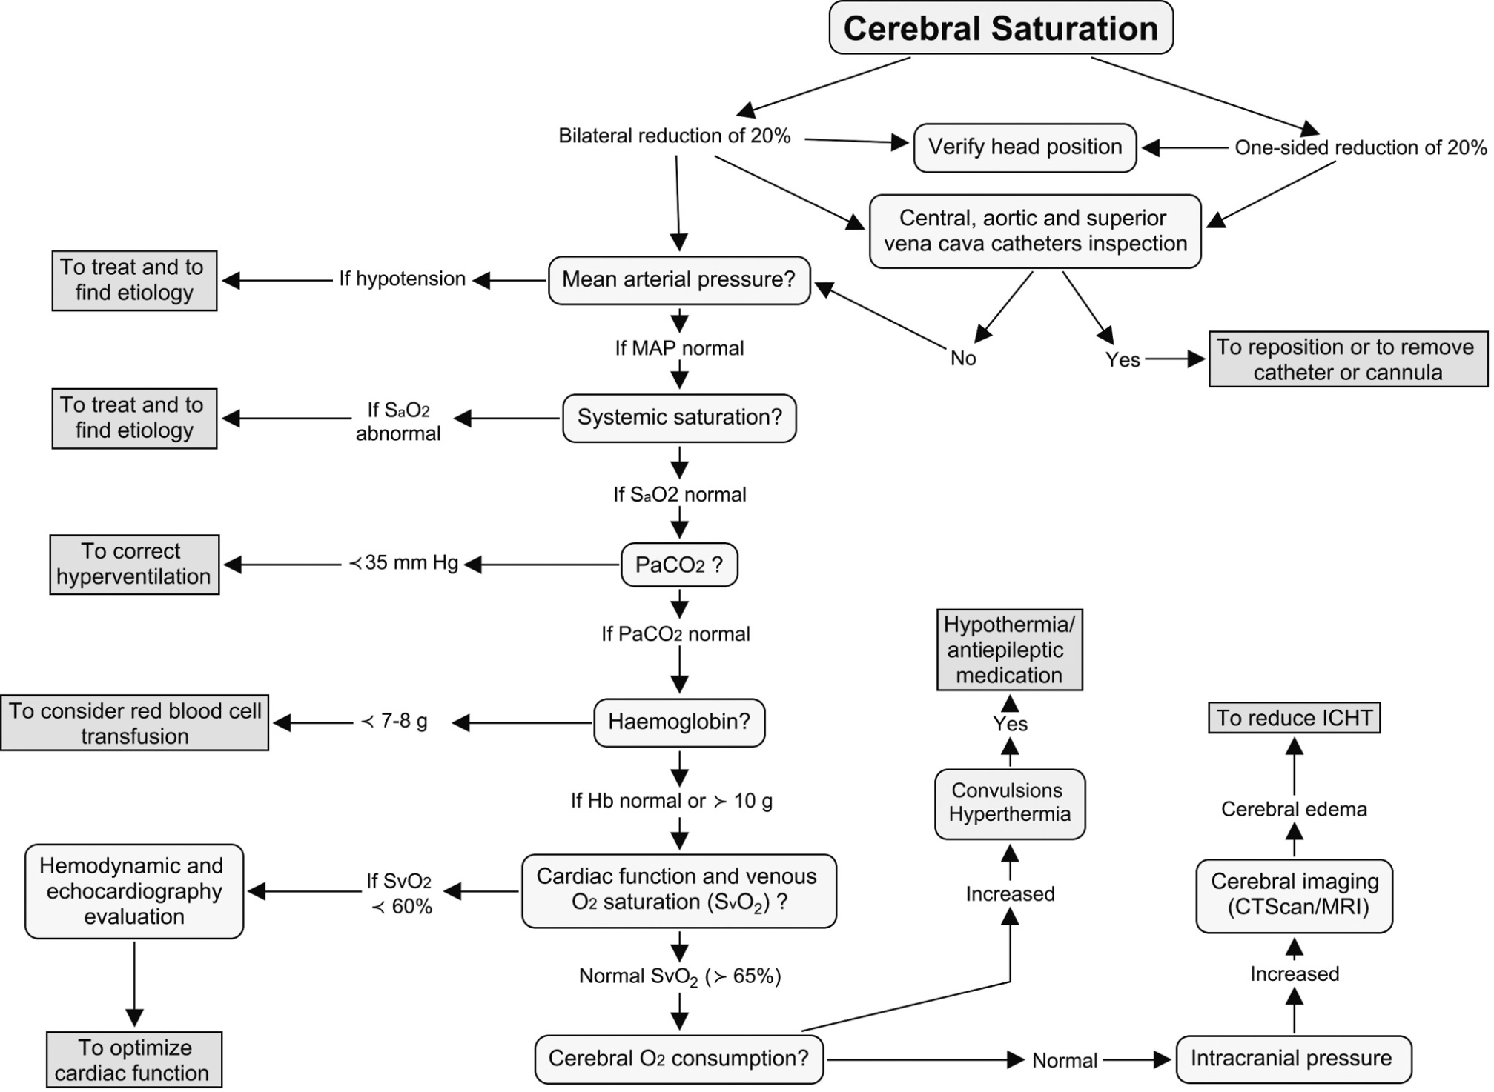

Slide 17
Case Studies
17 |
Covidien Respiratory and Monitoring Solutions | August 15, 2019 | Confidential
Notes:
17

Slide 18
Clinical Scenario:
Low Cardiac Output
Patient Description
This pediatric patient is several days out from a congenital heart repair and has been clinically stable. Acute postoperative near-arrest situation has occurred in the step-down unit. Monitoring begins once the patient returns to the Ped CVICU.
Summary of Clinical Course
    Fluid resuscitation results in minimal rSO₂ improvement
    Inotropic drug support given for low BP. The vital signs stabilize but only the somatic rSO₂ responds, no improvement in cerebral perfusion.
    Sedation and intubation result in a dramatic improvement in both cerebral and somatic rSO₂ (perfusion adequacy)
    Blood transfusion is used to treat low H&H due to hemodilution.
Impact of INVOS™ System monitoring:
Early indication of physiologic response to bedside treatments and interventions.
18 |
Covidien Respiratory and Monitoring Solutions | August 15, 2019 | Confidential
Notes:
8. Cases-Clinical Value/Examples
Safety benefit in clinical practice
Clinical outcome benefit of NIRS-guided hemodynamic management
18

Slide 19
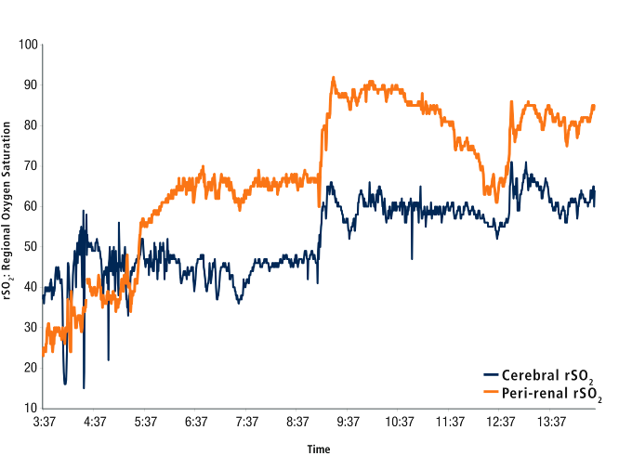
Clinical Scenario:
Low Cardiac Output
Sedation/Intubation
VSS, yet poor
Cerebral rSO2
Inotropes given
Blood transfusion
Fluids Given
Underlying data and case notes on file ISC-10001.
19 |
Covidien Respiratory and Monitoring Solutions | August 15, 2019 | Confidential
Notes:
8. Cases-Clinical Value/Examples
Safety benefit in clinical practice
Clinical outcome benefit of NIRS-guided hemodynamic management
FOUR MAIN POINTS
rSO2 showed efficacy of:
Volume administration (fluids given)
Drug support for cardiac output (inotropes given)
Sedation
Blood transfusion
Case Highlights:
Somatic and cerebral rSO₂ reversed, centralizing CO to vital organs. (compensated shock)
Clearly able to track effect of interventions in real time; note response to inotropic and fluid support
Note normal “vital signs” despite inadequate cerebral perfusion (~low 40s).
Note response to sedation and intubation. Reduction in sympathetic stress and vascular resistance.
Note gradual downward trend in somatic values following intubation and sedation and stable cerebral measurement
Note almost immediate response to PRBC transfusion.
INVOS™ monitoring provided immediate feedback to the clinician to validate the effectiveness of treatment and interventions.
Rapid intervention in shock patients is critical in avoiding progression to uncompensated stage of shock and eventual irreversible cardiovascular collapse.
19

Slide 20
Clinical Scenario:
Inadvertent Hyperventilation
Patient Description
12 week old 4.9 kg infant
Repair of coarctation of aorta
Summary of Clinical Course
Patient transported from CVOR to PICU with INVOS™ Monitor
During transport manually ventilated with Ambu-Bag
Upon arrival in PICU, delay in transition to mechanical ventilator
Cerebral rSO₂ values dropped progressively until mechanical ventilator connected
ABG showed hypocarbia secondary to hyperventilation
INVOS System Application
Hypocapnia and cerebral vasoconstriction was indentified by INVOS monitoring
Acute changes in CO₂ affect cerebral vascular resistance and INVOS™ System values identified alteration in perfusion in this hypocarbic state
20 |
Covidien Respiratory and Monitoring Solutions | August 15, 2019 | Confidential
Notes:
8. Cases-Clinical Value/Examples
Safety benefit in clinical practice
Clinical outcome benefit of NIRS-guided hemodynamic management
20

Slide 21
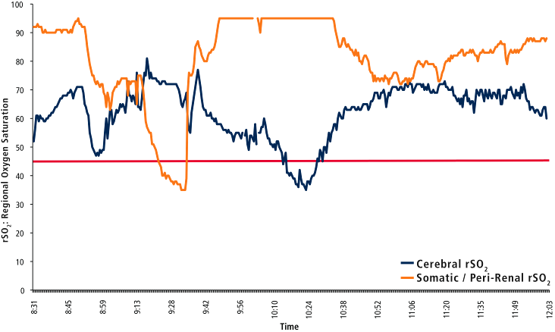
Clinical Scenario:
Inadvertent Hyperventilation
Set Baseline in OR
PaCO₂ 29.5
Cerebral Intervention Threshold
Arrival to PICU: Manual Ventilation
Ventilator connected
Underlying data and case notes on file ISC-10093.
21 |
Covidien Respiratory and Monitoring Solutions | August 15, 2019 | Confidential
Notes:
8. Cases-Clinical Value/Examples
Safety benefit in clinical practice
Clinical outcome benefit of NIRS-guided hemodynamic management
Intra-hospital transport from OR to PICU for post-op management
Hand-bagging is a standard method of ventilation during intra-hospital patient transport.
Hand-bagging does not provide feedback on tidal volume delivered to the patient, and tidal volumes are highly variable during manual ventilation.
Note the gradual drop in cerebral rSO₂ during transport to OR from ~ 0940 to ~1024 when mechanical ventilation was initiated.
The cerebral vasculature is highly reactive to CO₂ levels, hypocarbia resulting in vasoconstriction, diminished perfusion.
Establishing normal ventilation allowed patient to return to a more normo-carbic level with concurrent improvement in cerebral perfusion.

Slide 22
Clinical Scenario:
Patent Ductus Arteriosus
Meier SD, Eble BK, Stapleton GE, Morales DL, Chang AC, Andropoulos DB. Mesenteric oxyhemoglobin desaturation improves with patent ductus arteriosus ligation. J Perinatol. 2006;26(9):562-564.
22 |
Covidien Respiratory and Monitoring Solutions | August 15, 2019 | Confidential
Patient Description
  32 weeks gestation, 1713 gm infant
Summary of Clinical Course
  Day of life 8: Diagnosed with PFO, PDA
  Left -right shunt and SVT
  Unsuccessful closure of PDA with indomethacin
  Digoxin, diuretic and propranolol
INVOS™ System Application
  Cerebral and mesenteric monitoring
  Day of life 27- Surgical ligation of PDA w/ INVOS System intraoperative monitoring
  Demonstrates profound improvement in somatic perfusion following ligation of PDA
Notes:
8. Cases-Clinical Value/Examples
Safety benefit in clinical practice
Clinical outcome benefit of NIRS-guided hemodynamic management
This is a 1713 g infant born at 32 weeks gestation.
DOL 8 diagnosed with a 3 mm PDA with left to right shunting, which alters the blood distribution to vital organs.
Unsuccessful closure was attempted with indomethacin.
Surgical ligation done on DOL 27, using INVOS™ technology to monitor cerebral and abdominal regional perfusion
Definitions
DOL = Day of life
PFO-patent foramen ovale
PDA-patent ductus arteriosus
SVT-supra ventricular tachycardia
Digoxin and propranolol (as shown on slide): decrease heart rate due to tachycardia

Slide 23
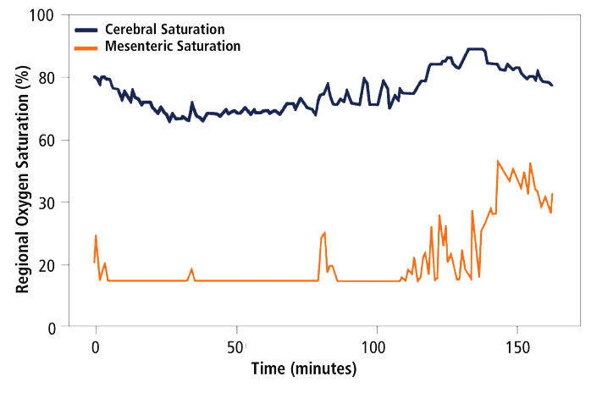
Clinical Scenario:
Patent Ductus Arteriosus
PDA ligation
27 days old
32 wks GA
1713 gm
Ischemia
Meier SD, Eble BK, Stapleton GE, Morales DL, Chang AC, Andropoulos DB. Mesenteric oxyhemoglobin desaturation improves with patent ductus arteriosus ligation. J Perinatol. 2006;26(9):562-564.
23 |
Covidien Respiratory and Monitoring Solutions | August 15, 2019 | Confidential
Notes:
8. Cases-Clinical Value/Examples
Safety benefit in clinical practice
Clinical outcome benefit of NIRS-guided hemodynamic management
Clinical Scenario: Premature Infant with a patent ductus arteriosus (MEIER)
This “flatline” in mesenteric rSO₂ reflects what some neonatologists are calling “abdominal silence.” This is a sign of clinically ominous biology. When seen, the care team should step through its “rule-out” diagnosis to troubleshoot the cause and intervene.
A PDA steals CO from the vital organs by shunting blood L to R from systemic circulation to the pulmonary bed.
Systemic organs at risk for hypoxic-ischemic injury. There is a higher incidence of NEC in pre-term infants with PDA.
The graph shows restoration of somatic (abdominal) blood flow after ligation of a PDA.
Note the concurrent improvement in cerebral rSO₂ following PDA ligation. Cerebral perfusion can also be affected by the PDA.
NIRS can be applied to the medical management of PDA to monitor response to treatment, giving quicker assessment of the need for surgery.
Show monitor screen pre-procedure
Pre-ligation: CrSO₂ = 77% MrSO₂ = 16%
SpO₂ 92%,
SP Ligation: CrSO₂ = 89% MrSO₂= 34%
Clinical Scenario: Premature Infant with a Patent Ductus Arteriosus (MEIER)
20% to 60% of preterm infants or those with RDS may be affected by a hemodynamically significant PDA, stealing flow to the vital organs by shunting blood L to R from systemic to the pulmonary bed, putting systemic organs at risk for hypoxic-ischemic injury. In preterm infants with limited cardiac output, cerebral perfusion may be protected by autoregulation. In this patient, pre-ductal closure mesenteric rSO₂ was as low as 15%. Immediately following ductal ligation, the mesenteric rSO₂ increased, demonstrating an increase in mesenteric tissue perfusion. The investigators note that abnormally low rSO₂ may be useful in selecting patients with hemodynamically significant PDAs that warrant medical/surgical intervention. Low abdominal rSO₂ may reflect intestinal ischemia, which if prolonged may lead to necrotizing enterocolitis.
Shows restoration of mesenteric blood flow after ligation of a PDA.
Similar applications of NIRS are being used for monitoring effectiveness of pharmacological Rx of PDA.
23

Slide 24
For more information please visit:
http://www.medtronic.com/covidien/products/cerebral-somatic-oximetry
Thank you for your attention
Paula Smith RRT/CRE
Advanced Parameters Specialist
Medtronic Canada
paula.smith@medtronic.com
(705) 238-7544
24 |
Covidien Respiratory and Monitoring Solutions | August 15, 2019 | Confidential
Notes:
24

